Slide 1

Slide 1
Social Data Mining Techniques
Social Media Management application
…
Dan Pham
Suhong Liang
Kostiantyn Reva
Janine Marie Rosales

Slide 2

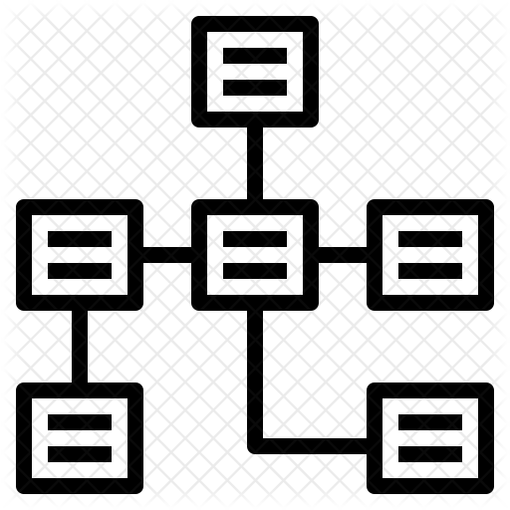



Project analysis slide 2
Contents
DATA SOURCES
DATA MODEL
TECH STACK
TEXT AND IMAGE
ANALYSIS
RESULT
DEMO

Slide 3


Slide 10
DATA SOURCE
GitHub is a code hosting platform for version control and collaboration. It lets you and others work together on projects from anywhere.
GitHub is a web-based hosting service for version control using Git. It is mostly used for computer code. It offers all of the distributed version control and source code management functionality of Git as well as adding its own features
https://developer.github.com/
https://en.wikipedia.org/wiki/GitHub
10

Slide 4

Project analysis slide 6
Project boards are made up of issues, pull requests, and notes that are categorized as cards in columns of your choosing.
Can collect user feedback, report software bugs, and organize tasks you'd like to accomplish with issues in a repository. Issues can act as more than just a place to report software bugs.
PROJECT
ISSUE
USER
PICTURE
COMMENTS
collaborators or team members can comment on the comparison of files between the two specified branches, or leave general comments on the project as a whole
https://help.github.com/en

Slide 5
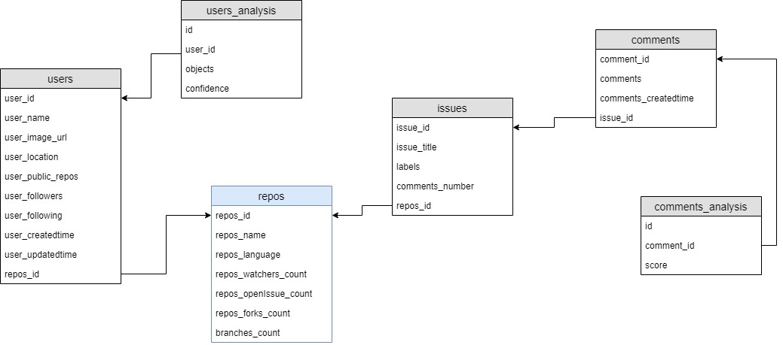
Project analysis slide 3
Data Model
POSTGRESQL

Slide 6





Project analysis slide 3
Tech Stack
PYTHON
POSTGRESQL
FLASK
VUE.JS
CHART.JS
***
***
***
***
***

Slide 7


Slide 5
ANALYSIS
SENTIMENT ANALYSIS
IMAGE RECOGNITION
USER
PICTURE
COMMENTS
Computer Vision
Extract rich information from images to categorize and process visual data—and perform machine-assisted moderation of images to help curate your services.
Text Analytics
Detect sentiment, key phrases, and language from your text
https://azure.microsoft.com/en-ca/services/cognitive-services/text-analytics/
https://azure.microsoft.com/en-ca/services/cognitive-services/computer-vision/
5
Notes:
In term of analysis, we use Azure cognitive services to do sentiment analysis for the comments and to do image recognition for the user profile of github data. specifically, we use text analytics service for text mining and Computer vision for the image identify. And now I am gonna pass it on to Dan. She will talk about the result of analysis we got from the data.

Slide 8
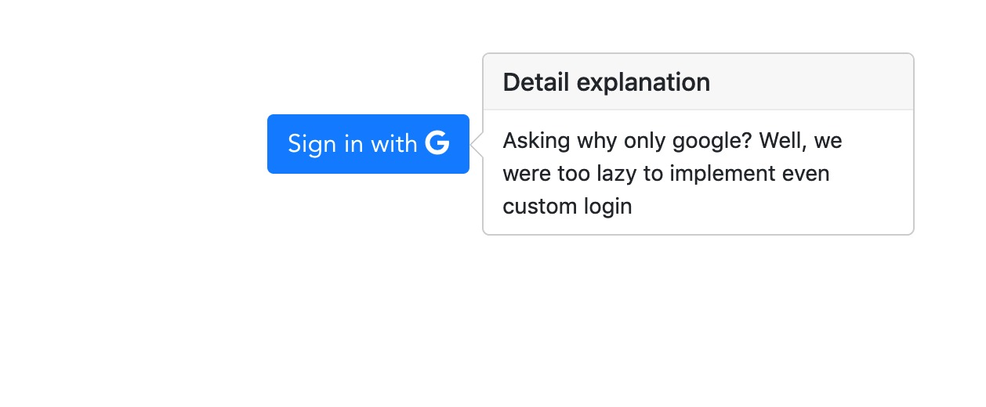
Project analysis slide 5
RESULT

Slide 9
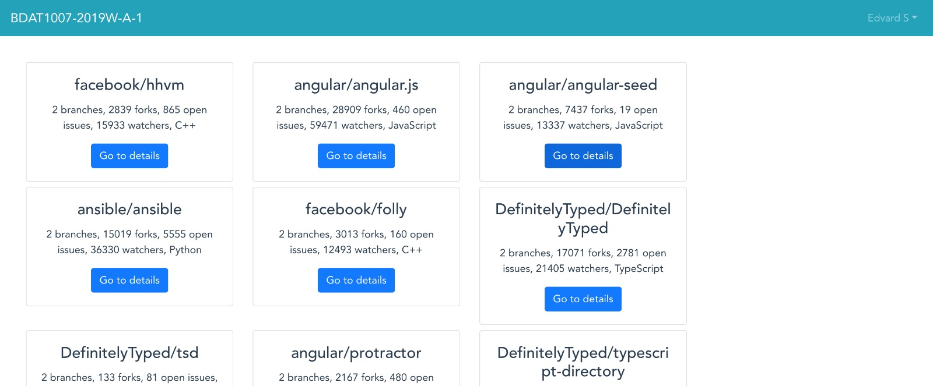
Project analysis slide 5
RESULT

Slide 10
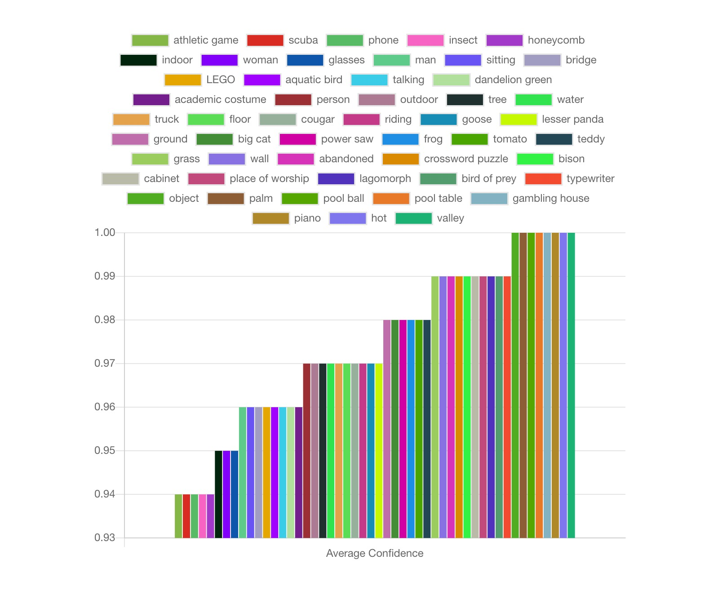
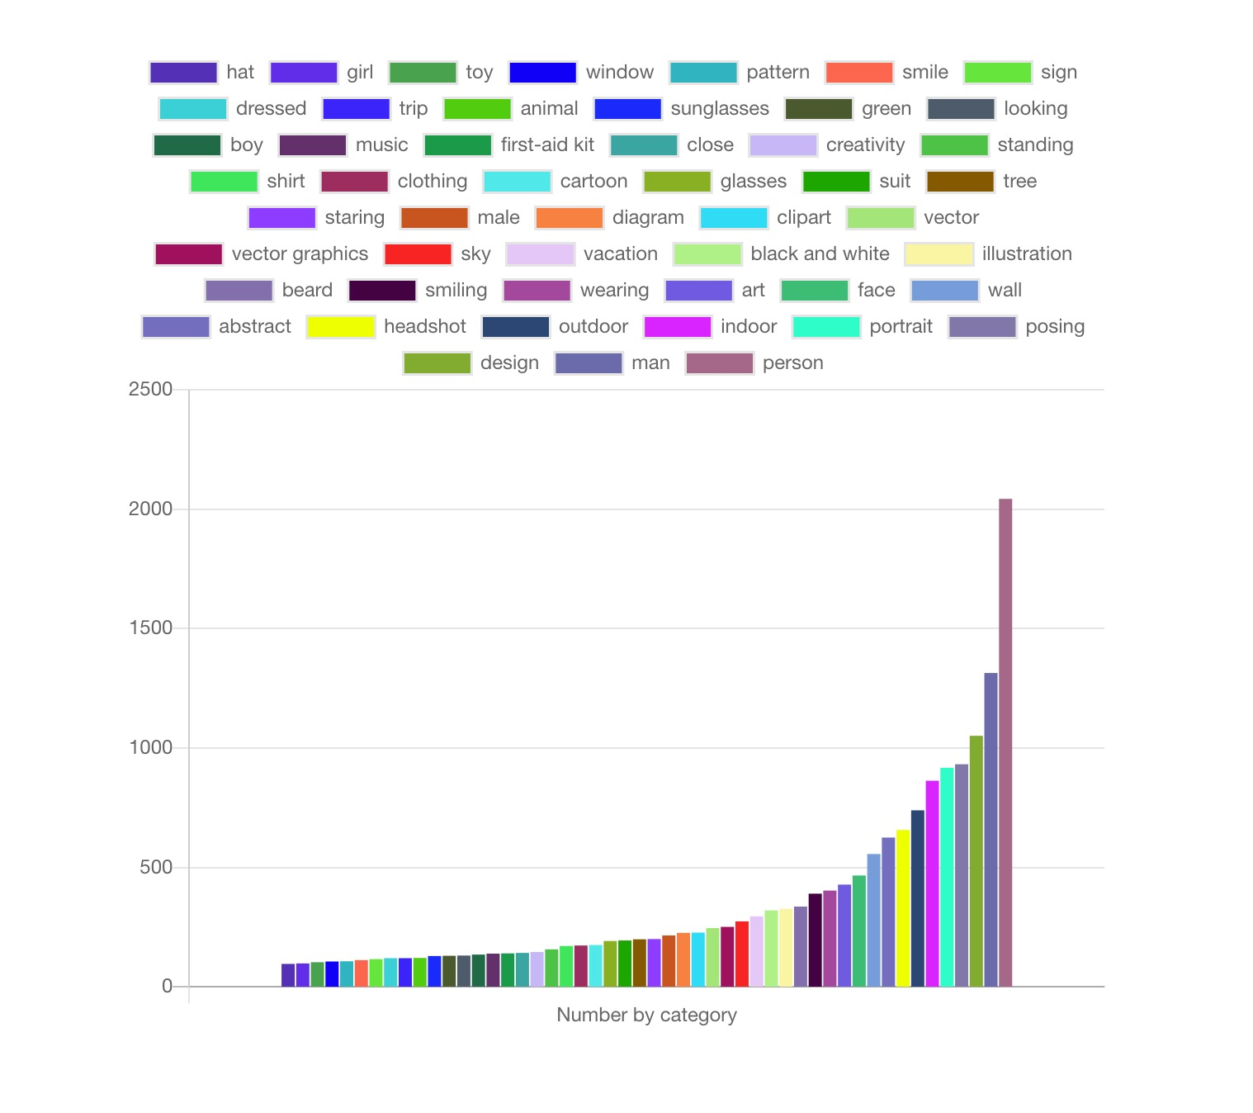
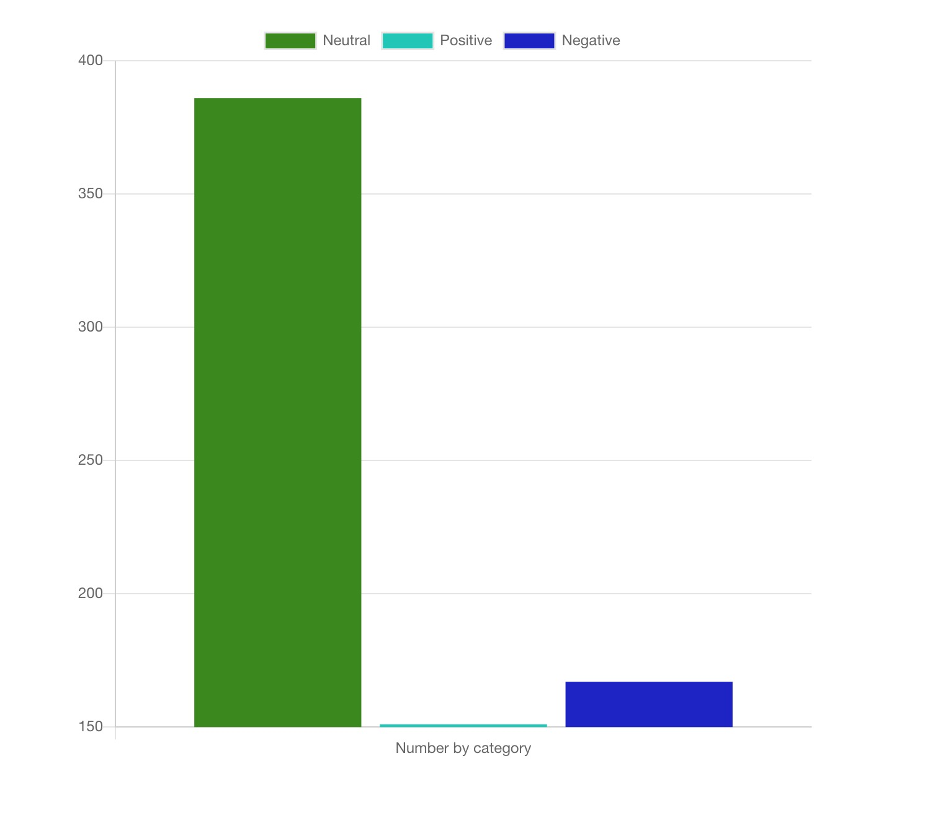
Project analysis slide 5
RESULT

Slide 11
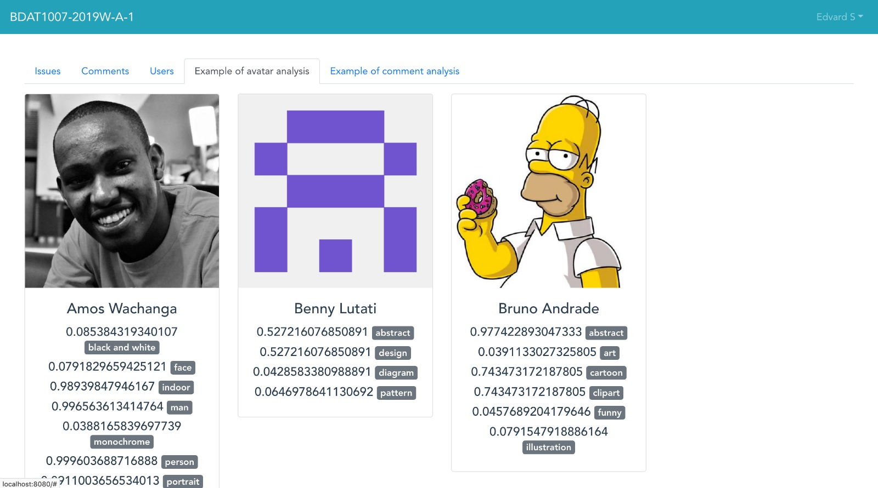
Project analysis slide 5
RESULT

Slide 12
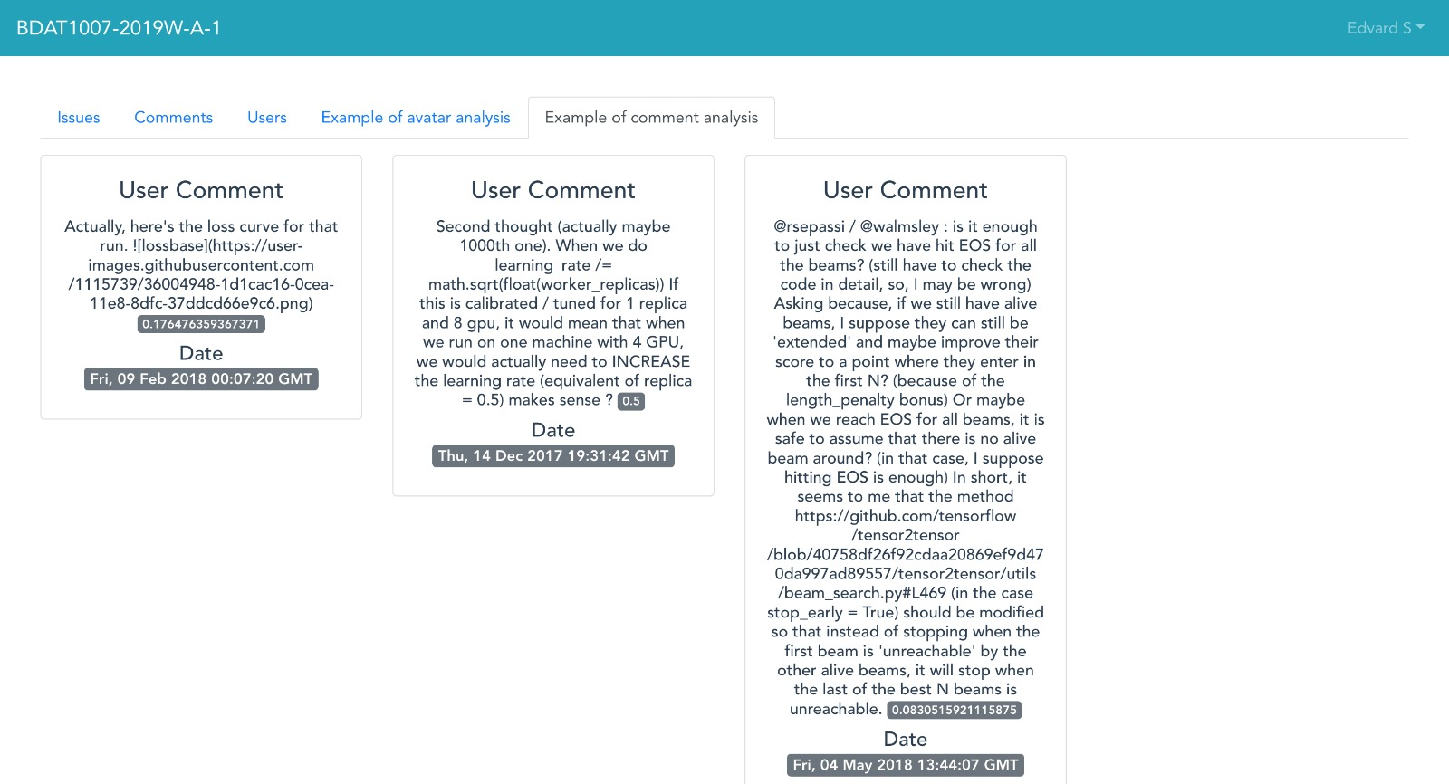
Project analysis slide 5
RESULT

Slide 13

Project analysis slide 5
Demo
http://3.14.29.149:8080/

Slide 14
Slide 11
THANK YOU
Dan | Suhong | Kostiantyn | Janine

